Slide 1


Slide 2

NETAJI SUBHASH INSTITUTE OF TECHNOLOGY
(NSIT), BIHTA, PATNA
WELCOME TO THE PRESENTATION
On the Occasion of Engineer’s Day - 2026
DIGITAL INDIA
“from click to change””
TEAM :- TECH-TITANS💻🚀
MENTOR :- Mr. Shashi Ranjan
PRESENTED BY :- SHIKHA, ANURAG & RESHAMI

Slide 3
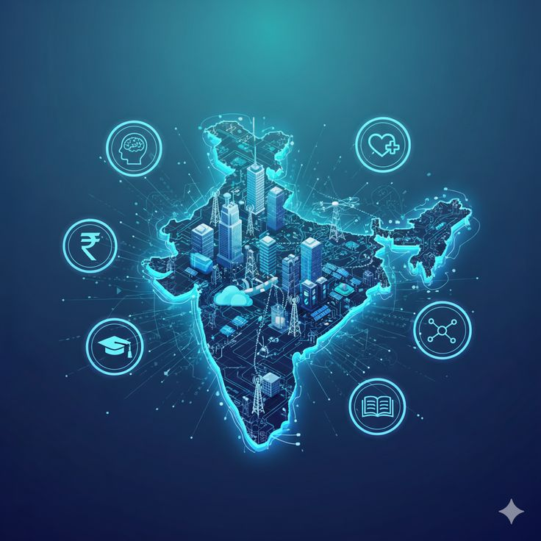
What is Digital India?
Digital India is a flagship programme of the
Government of India.
Launched on 1 July 2015
Provides digital access and government services
Vision: A digitally empowered society and knowledge economy

Slide 4
Why Digital India?
BEFORE DIGITAL INDIA
AFTER DIGITAL INDIA
Long Queues
Paperwork
Slow government services
Limited digital access
Online Services
Paperless process
Faster access
Digital connectivity

Slide 5
The 9 pillars of Digital India
Broadband Highways
Universal Access to Mobile Connectivity
Public Internet Access Programme
e-Governance
e-Kranti
Information for All
Electronics Manufacturing
IT for Jobs
Early Harvest Programmes

Slide 6
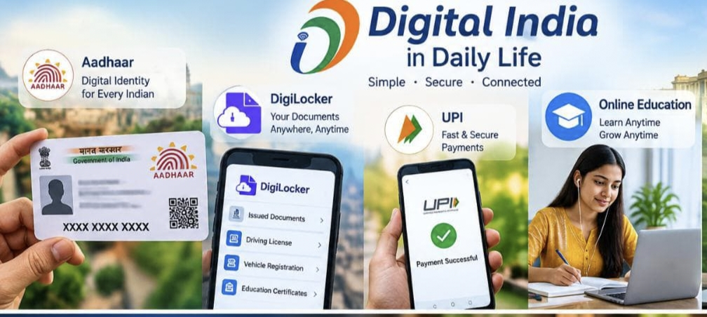
Digital India in Daily Life
Aadhaar & DigiLocker
it helps in accessing of digital identity and
important documents digitally.
UPI & Digital Payments
easily payment in one click through mobile phone.
Online Education
students can access online classes and study materials easily with the help of Internet.
E-Governance Services
nowadays government services provided through digital platform.
( Like online apply for certificates )

Slide 7
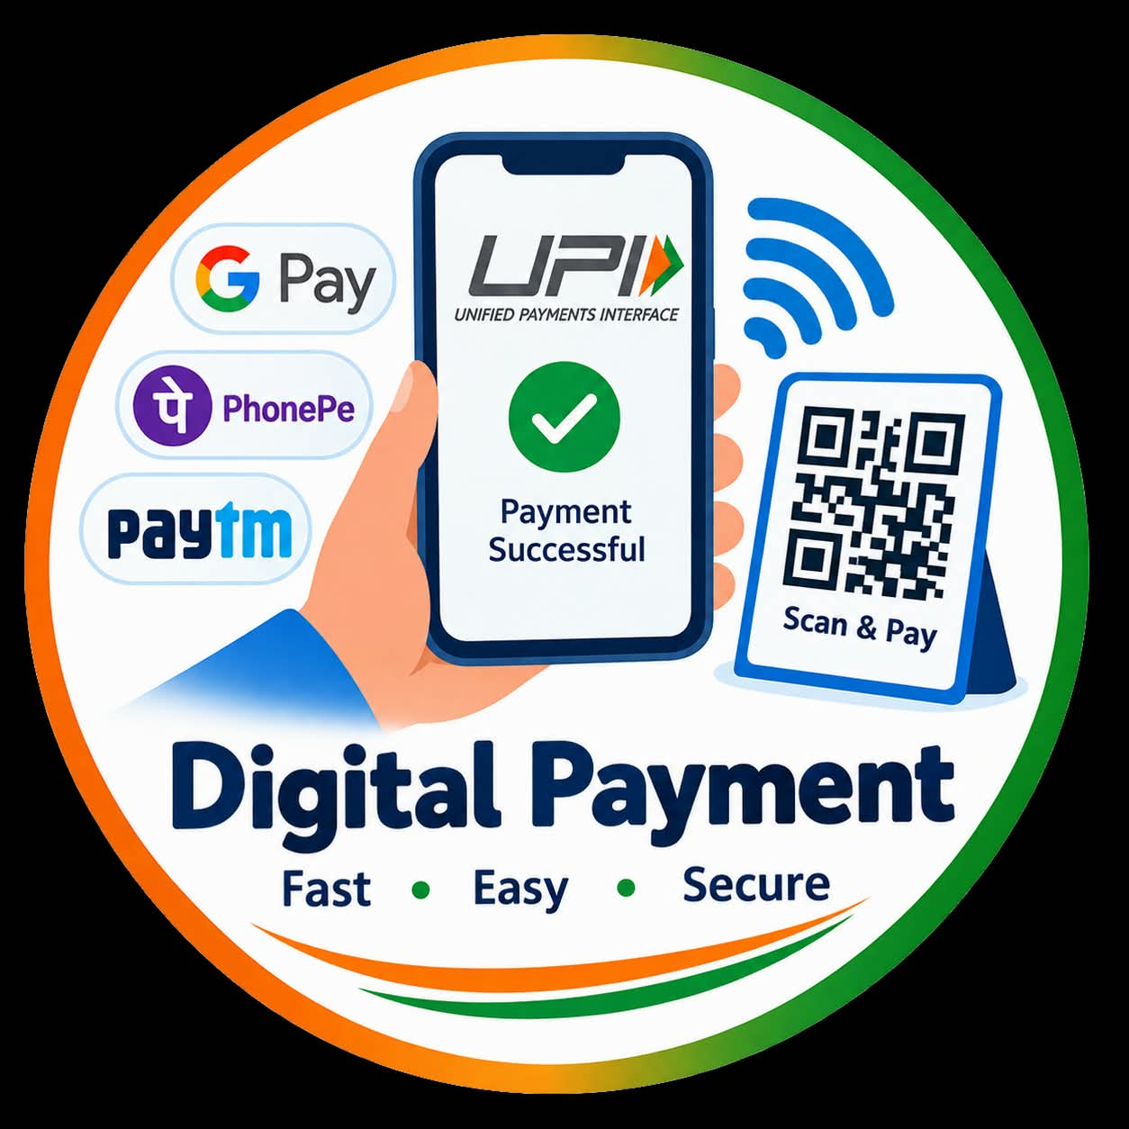
Digital Payments
UPI – Instant Digital Payments
Money can be transferred instantly using a mobile phone.
QR Code Payments
Payment can be made simply scanning a QR code.
Fast & Cashless Transactions
Digital payment make transactions quick and reduce the need for cash.
Financial Access for Everyone
Digital payments make banking and payment services easier to access.

Slide 8

Challenges of Digital India
Cybersecurity & Data Privacy
Protecting personal information and digital systems from cyber
threats.
Digital Literacy
People need basic skills to use digital devices and online services safely.
Digital Divide
Not everyone has equal access to the internet and digital devices.
Online Fraud Awareness
People need to recognize and avoid online scams and fraudulent messages.

Slide 9
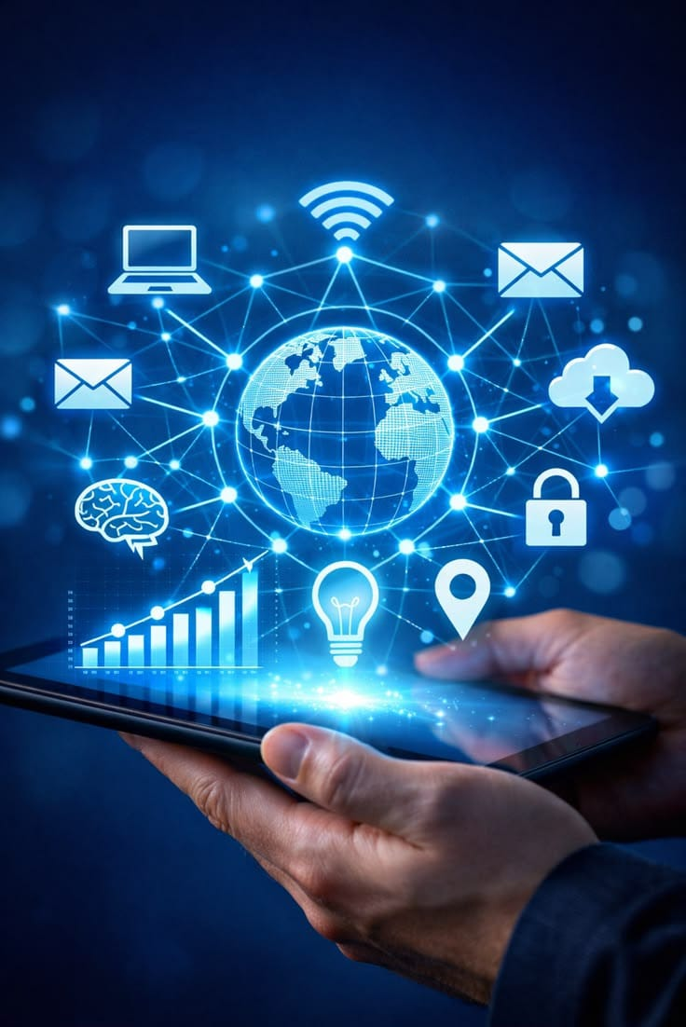
The Future of Digital India
Artificial Intelligence (AI)
AI can make digital services smarter and more efficient.
5G & Next-Generation Connectivity
Faster networks can improve communication and digital services.
Stronger Cybersecurity
Better security will help protect digital systems and personal data
Digital innovation & Smart infrastructure
New technologies can make cities and public services smarter

Slide 10
Conclusion……….
“One Click Can Connect a citizen to a New Possibility.”
Digital India is not just about technology – it is about empowering people and transforming lives
“THANK YOU!”

